Slide 1
RUSTikales Rust for beginners

Slide 2
Plan for today

Slide 3
Plan for today
Recap

Slide 4
Plan for today
Recap
Structs

Slide 5
Plan for today
Recap
Structs
Associated functions

Slide 6
Plan for today
Recap
Structs
Associated functions
Methods

Slide 7
Recap

Slide 8
Recap
Ownership-Model
References
Borrow Checker

Slide 9
Recap
Ownership-Model
References
Borrow Checker
Functions are declared using the keyword fn
Functions can take in parameters
Functions can return values

Slide 10
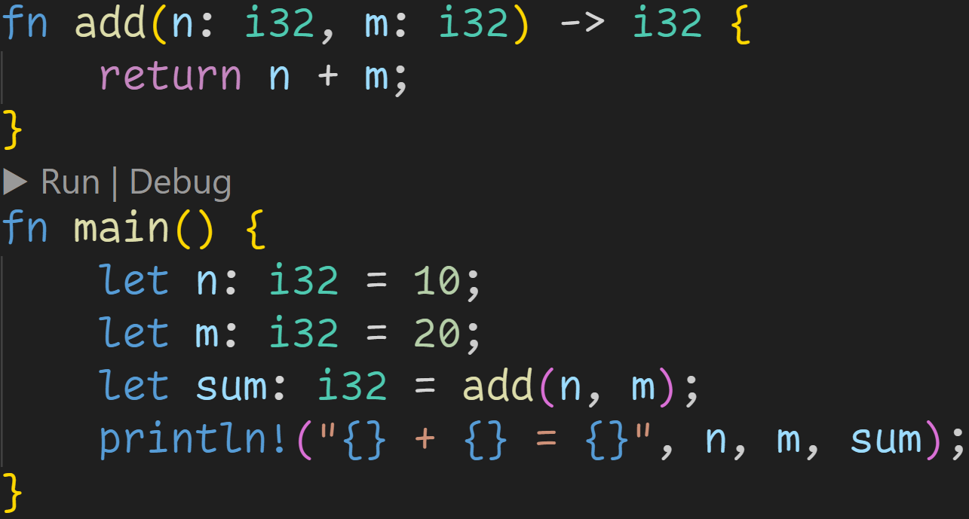
Recap

Slide 11
Recap
Return type

Slide 12
Recap
Parameters

Slide 13
Recap
Function call
→ Every parameter requires an argument

Slide 14
Recap
Function call
→ Every parameter requires an argument → Returns a value which we can use

Slide 15
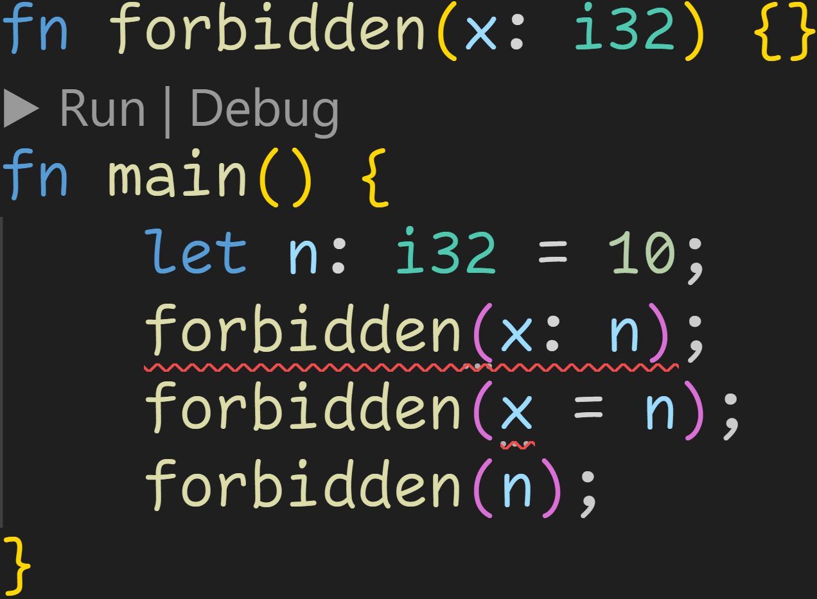
Recap

Slide 16
Recap
Rust does not support named arguments

Slide 17
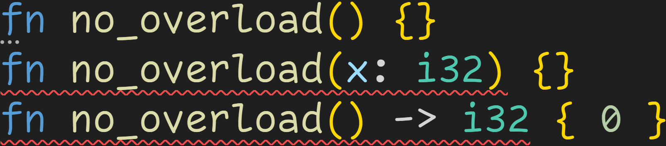
Recap

Slide 18
Recap
Rust does not support function overloads → You can only have one function with any given name in a module

Slide 19
Structs

Slide 20
Structs
Now that we‘re familiar with functions and basic types, we can write our first real programs
We want to create a console application where a ball bounces around the screen

Slide 21
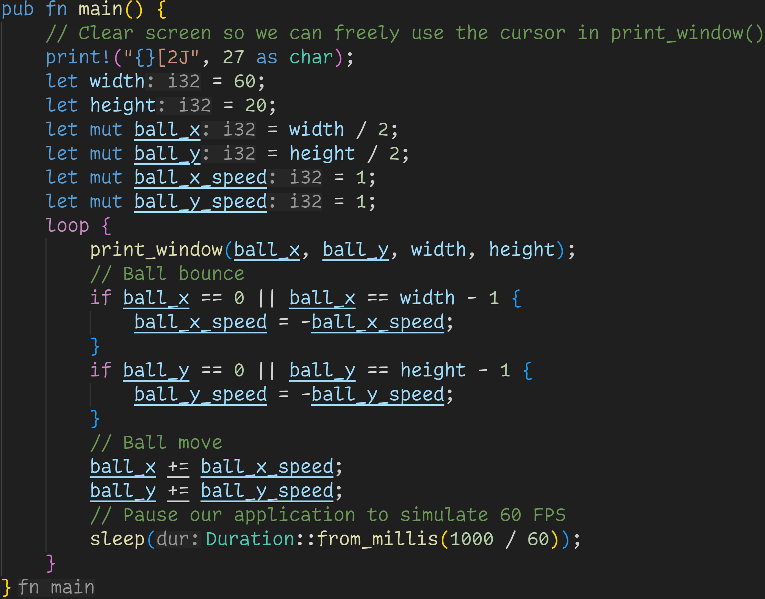

Slide 22
Normal loop, our application will never stop

Slide 23
Variables for the state of the application → Our world is 60x20 units big → Ball starts in the middle of the world → Ball moves to the bottom left

Slide 24
This function prints the current state to the console

Slide 25
Simple bouncing logic:
→ If we‘re at the edge of the world, invert the velocity → Ball moves in the opposite direction now → Breaks if the speed is not 1 :^)

Slide 26
Update the position of the ball

Slide 27
Rust is a fast language, we need to slow down our application so we can actually see the ball move

Slide 28
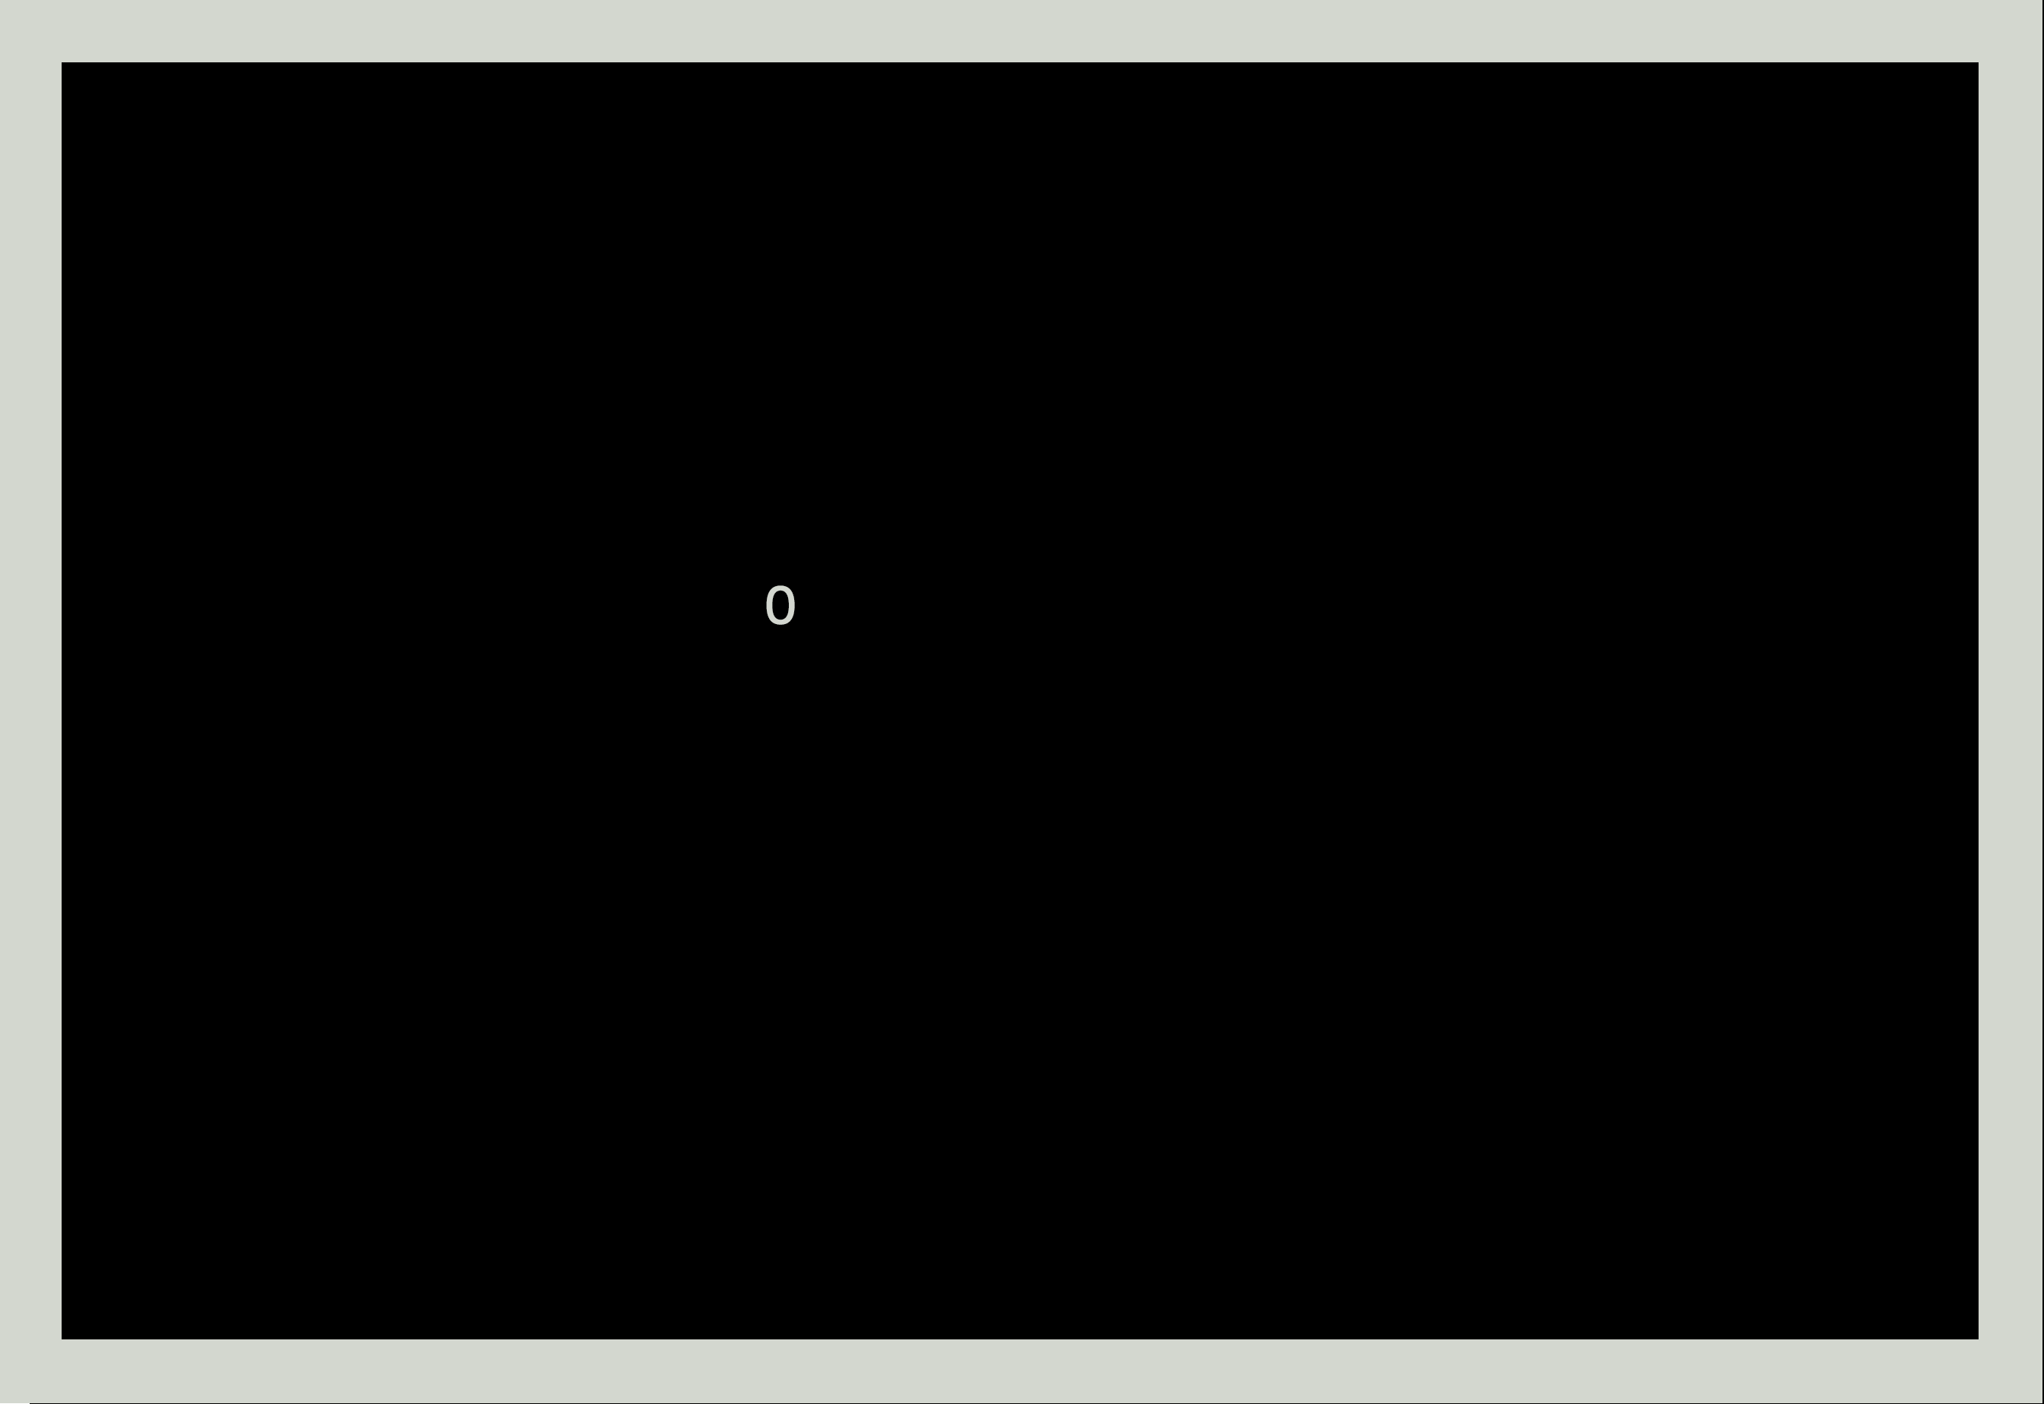
Our world looks like this:

Slide 29
Our world looks like this:
Our ball :^)

Slide 30
Notice how there is a lot of stuff to keep track of the ball state?

Slide 31
Notice how there is a lot of stuff to keep track of the ball state? → We need to initialize the ball → We need to update the ball

Slide 32
Structs
Structs are collections of values

Slide 33
Structs
Structs are collections of values
Structs allow us to create more complex data structures than just i32 or bool

Slide 34
Structs
Structs are collections of values
Structs allow us to create more complex data structures than just i32 or bool
Structs are declared using the keyword struct

Slide 35
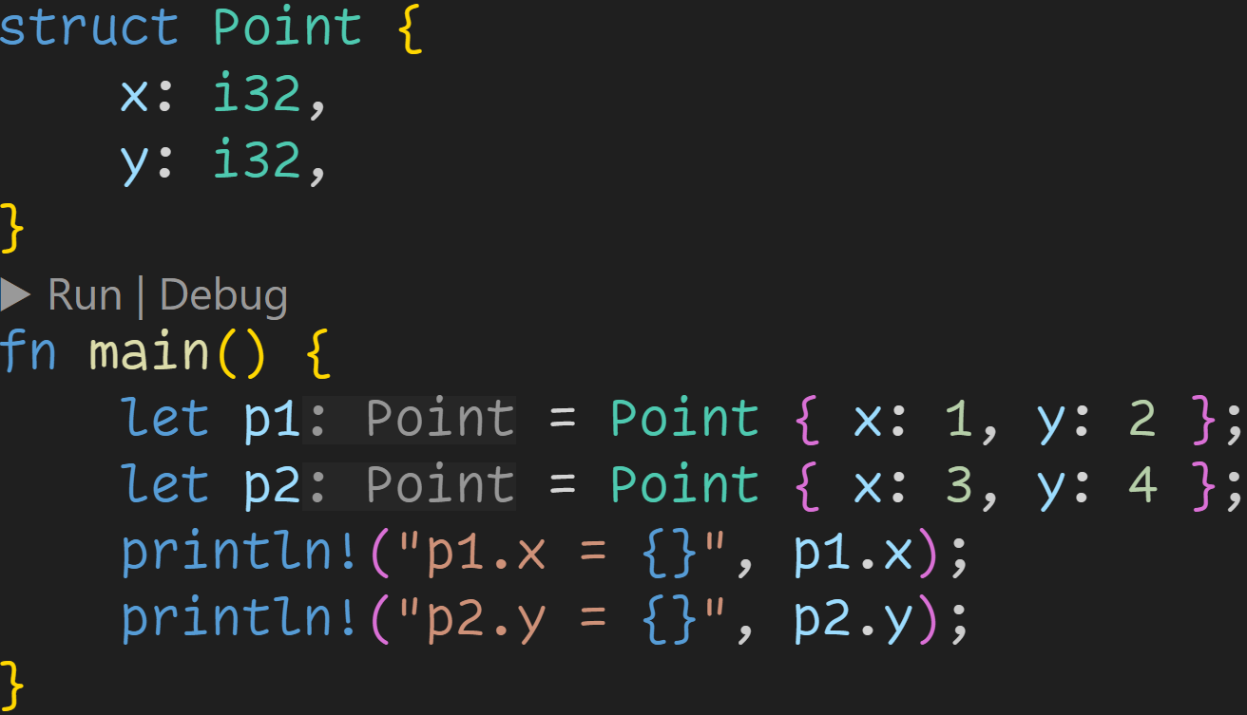
Structs

Slide 36
Structs
Struct declaration

Slide 37
Structs
Structs are made out of fields

Slide 38
Structs
Struct instantiation

Slide 39
Structs
Every field has to have a value

Slide 40
Structs
p1 and p2 are instances of type Point

Slide 41
Structs
Using the dot operator, we can access fields

Slide 42
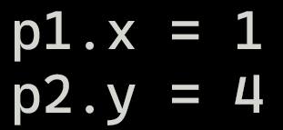
Structs

Slide 43
Structs

Slide 44
Structs

Slide 45
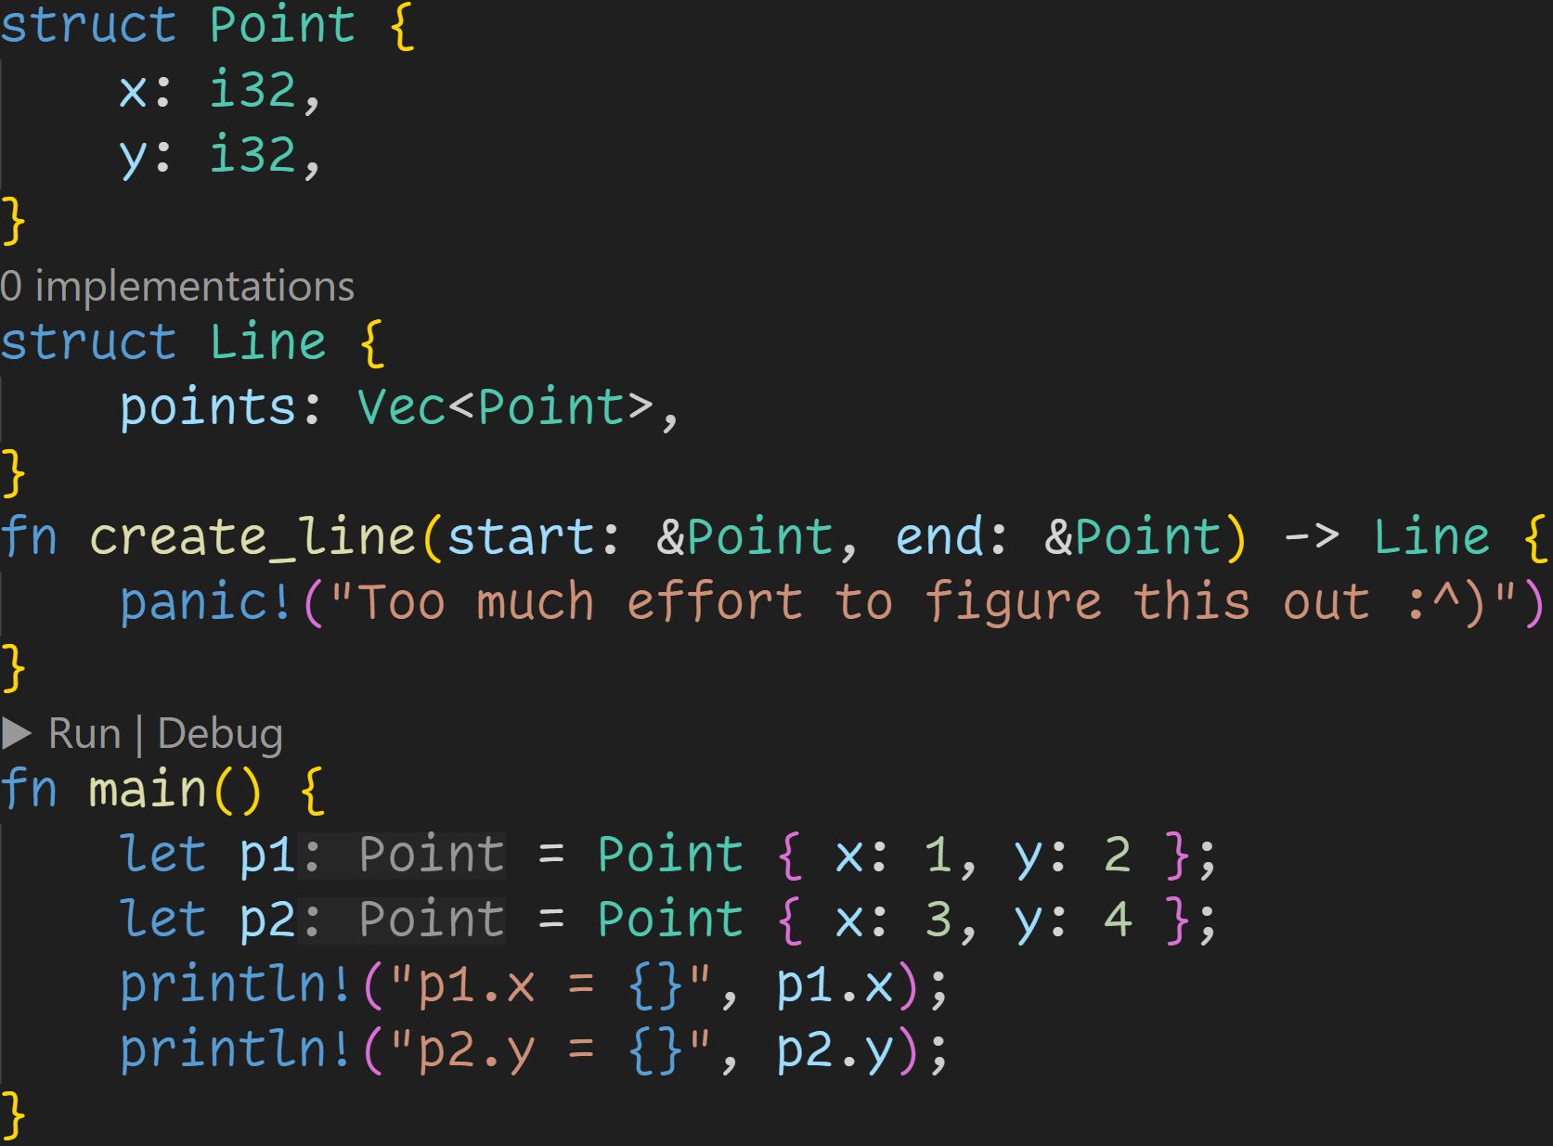
Structs
Structs are type definitions

Slide 46
Structs
Structs are type definitions → Fields can be structs themselves

Slide 47
Structs
Structs are type definitions → Fields can be structs themselves → We can pass structs as parameters

Slide 48
Structs
Structs are type definitions → Fields can be structs themselves → We can pass structs as parameters → We can return structs from functions

Slide 49
Structs
Structs are type definitions → Fields can be structs themselves → We can pass structs as parameters → We can return structs from functions → And, of course, variables can have struct types

Slide 50
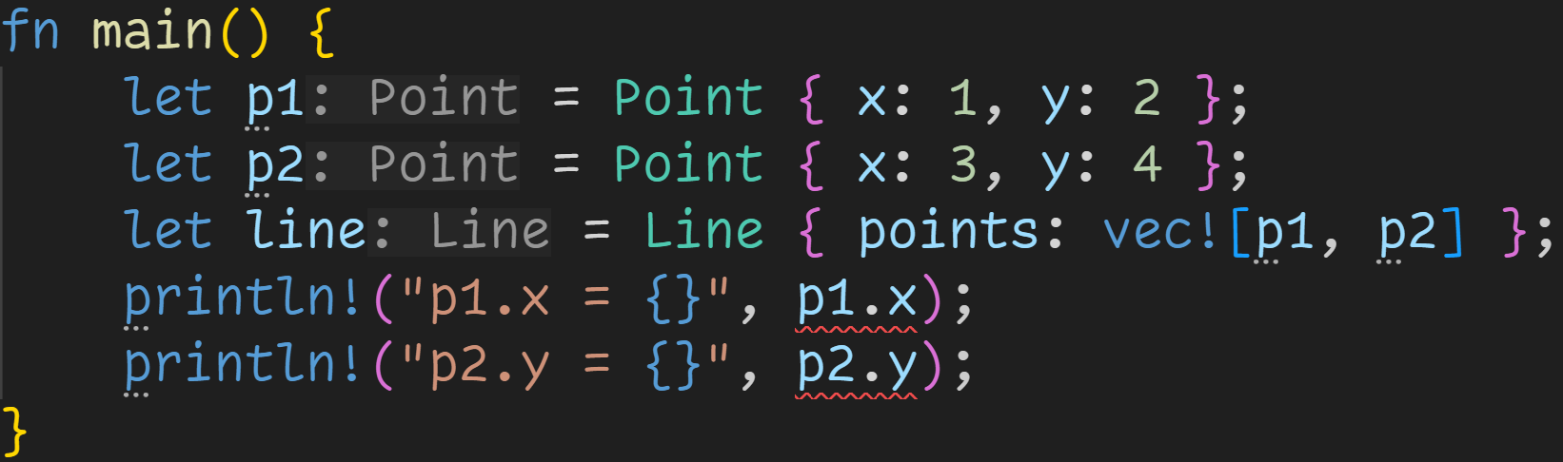
Structs

Slide 51
Structs
Normal Ownership and Borrow Checker rules apply to structs
→ By default, struct instances are always moved

Slide 52
Structs
p1 and p2 are moved into the line, we can‘t use them down here anymore!
→ Using traits we can fix that, those will be covered next week

Slide 53
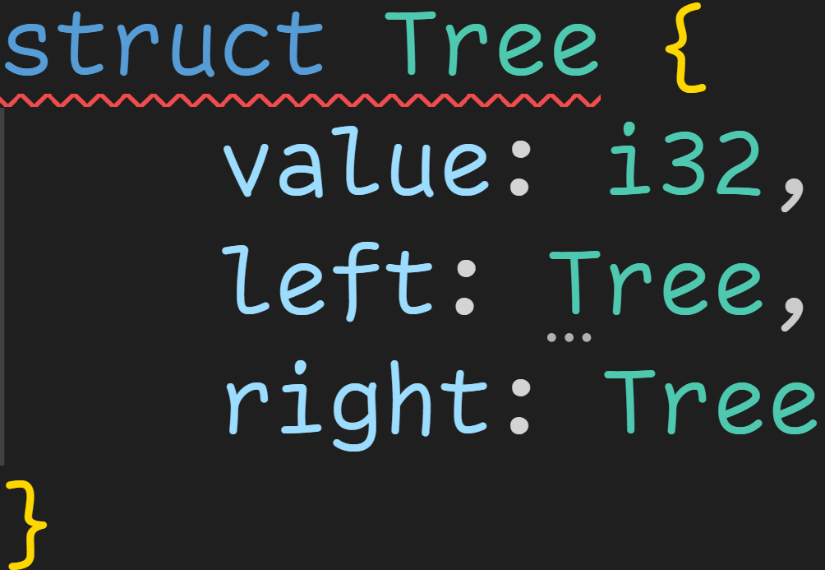
Structs
Struct instances, like other variables, are located on the Stack
→ Size of a struct must be known at compile time

Slide 54
Structs
Struct instances, like other variables, are located on the Stack
→ Size of a struct must be known at compile time → The size of a struct is the size of all its fields

Slide 55
Structs
Struct instances, like other variables, are located on the Stack
→ Size of a struct must be known at compile time → The size of a struct is the size of all its fields → Tree is recursive: We need the size of Tree to get its size! → Compiler error

Slide 56
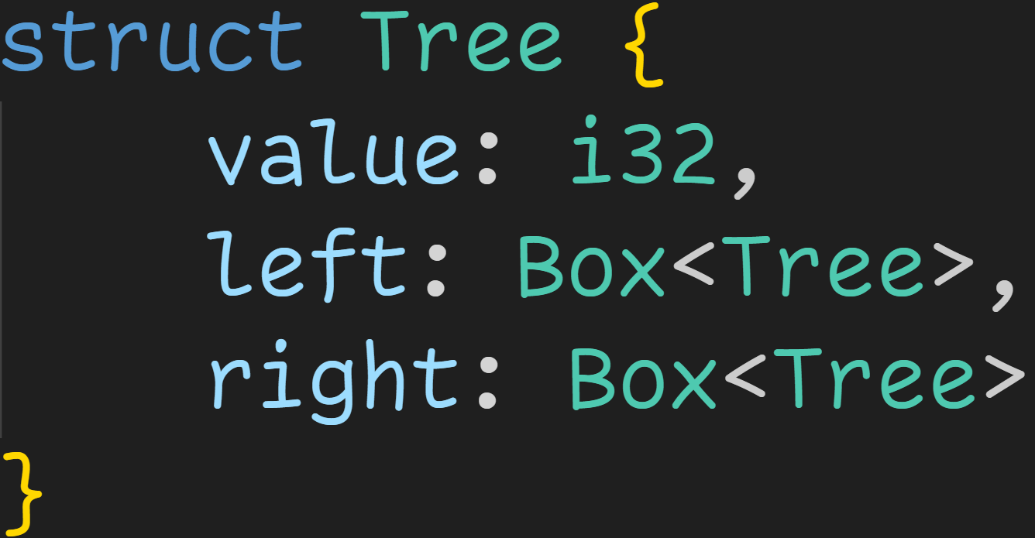
Structs
Struct instances, like other variables, are located on the Stack
→ Size of a struct must be known at compile time → The size of a struct is the size of all its fields → Tree is recursive: We need the size of Tree to get its size! → Compiler error
Solution: Add indirection
→ Box moves the value to the heap and is always pointer-sized

Slide 57
Structs
Struct instances, like other variables, are located on the Stack
→ Size of a struct must be known at compile time → The size of a struct is the size of all its fields → Tree is recursive: We need the size of Tree to get its size! → Compiler error
Solution: Add indirection
→ Box moves the value to the heap and is always pointer-sized → sizeof<Tree> = sizeof<i32> + 2 * sizeof<Box> bytes → sizeof<Tree> = 4 + 2 * 8 = 20 bytes

Slide 58
Associated functions

Slide 59
Associated functions
Associated functions are functions associated with a type

Slide 60
Associated functions
Associated functions are functions associated with a type
Associated functions allow us to implement logic for types

Slide 61
Associated functions
Associated functions are functions associated with a type
Associated functions allow us to implement logic for types
Associated functions are declared using the keyword impl

Slide 62
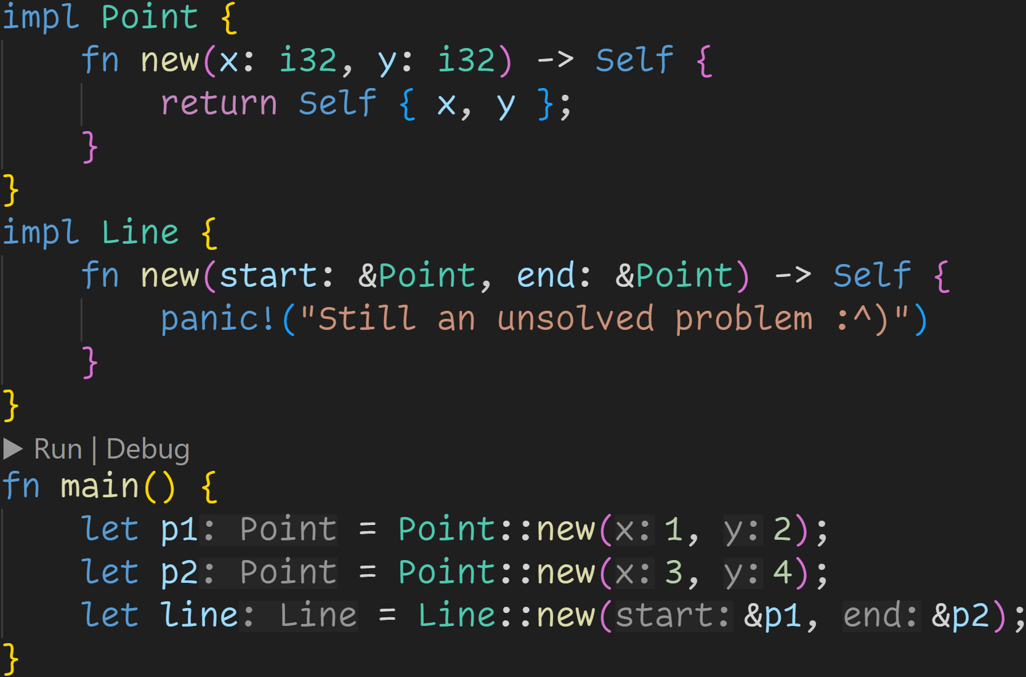

Slide 63
Every function we declare in here gets associated with the type Point

Slide 64
Every function we declare in here gets associated with the type Line

Slide 65
Self is a type alias for the type we‘re currently implementing

Slide 66
Point
Point
Self is a type alias for the type we‘re currently implementing
Line

Slide 67
In struct instantiations, if we assign the value of a variable to a field with the same name, we can save some typing

Slide 68
This line is equivalent to
return Point { x: x, y: y };

Slide 69
Because we‘re associating functions with a specific type, we can declare functions with the same name → Point::new(x, y) is different from Line::new(start, end)
→ Vec::new() is different from Point::new(x, y)
→ new() is different from Vec::new()

Slide 70
When calling associated functions, we always have to specify the type

Slide 71
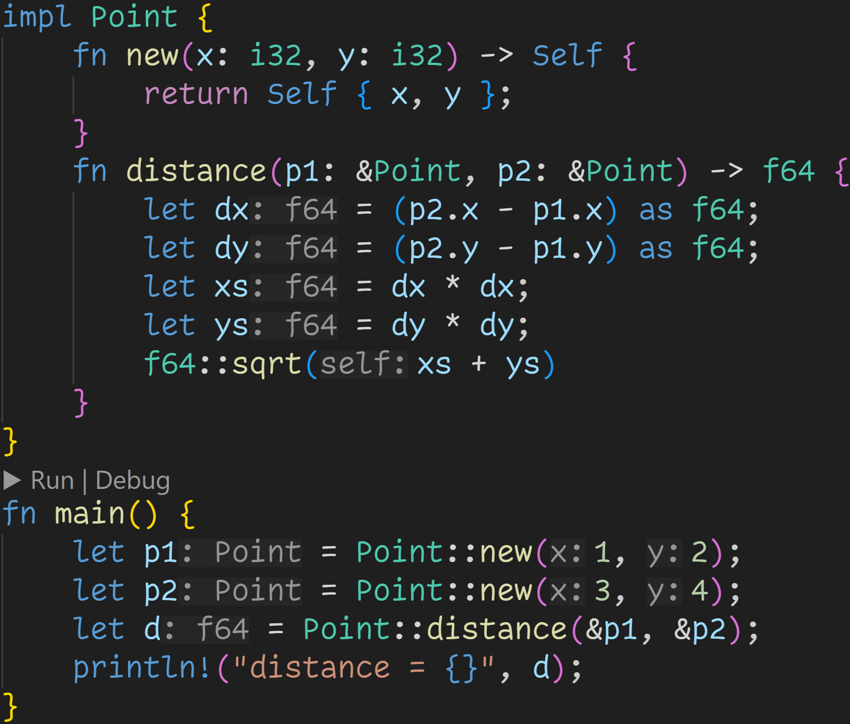

Slide 72
We can now implement special functions for our types
→ Here: Distance between two given points

Slide 73
The last expression in a function is also the return value
→ Writing return is optional

Slide 74
1/3
How many calls to associated functions are in this code snippet?

Slide 75
1/3
How many calls to associated functions are in this code snippet?
→ 4

Slide 76
Because we only borrow p1 and p2, we can still use them after this line

Slide 77
Methods

Slide 78
Methods
Methods are a special kind of associated functions

Slide 79
Methods
Methods are a special kind of associated functions
Methods are all associated functions where the first parameter is either self, &self or &mut self

Slide 80
Methods
Methods are a special kind of associated functions
Methods are all associated functions where the first parameter is either self, &self or &mut self
Methods allow us to easily call associated functions on struct instances

Slide 81
Currently an associated function
→ First parameter is not self

Slide 82
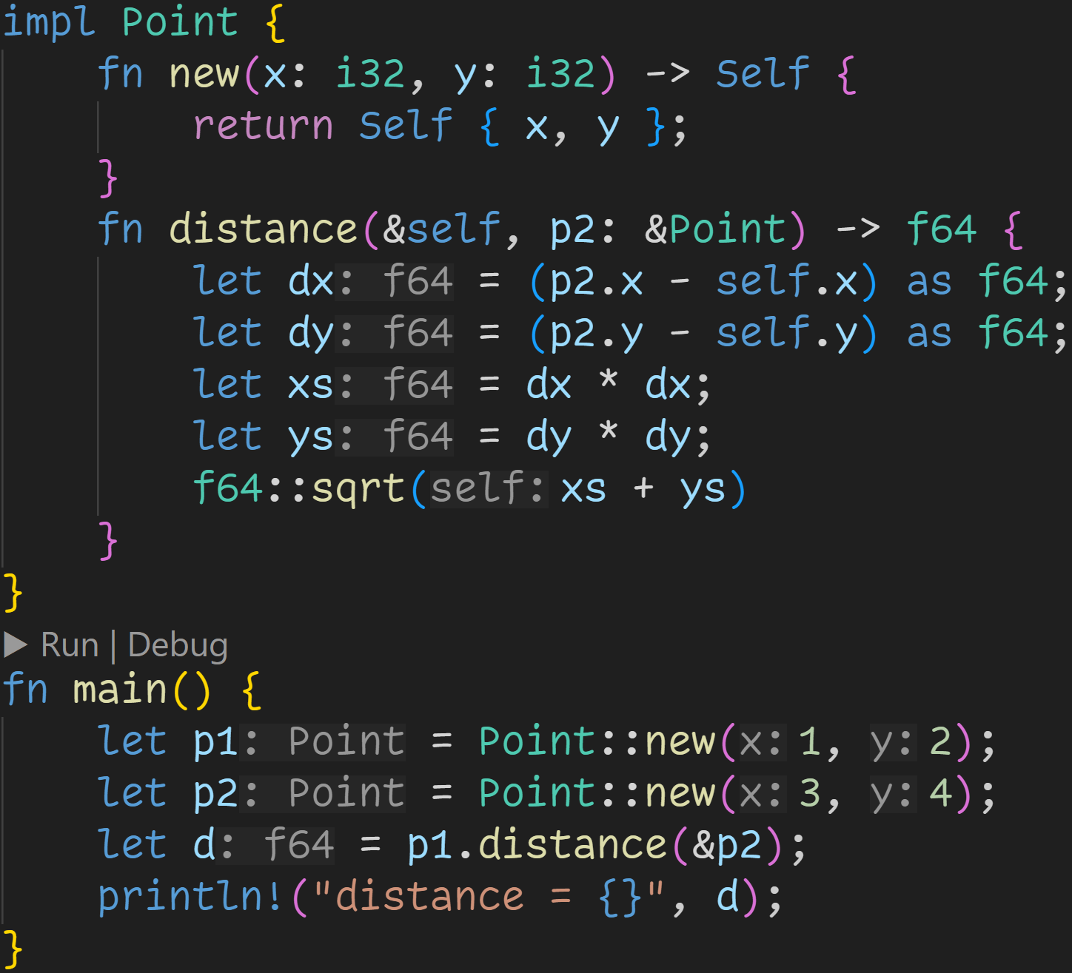

Slide 83
distance is now a method
→ First parameter is &self

Slide 84
self is now a specific instance of type Point
→ We don‘t need to provide the type, there‘s only one option what it can be

Slide 85
We can use the dot operator to call the method
→ p1 is passed as &self

Slide 86
We can use the dot operator to call the method
→ p1 is passed as &self → We now need to provide one less argument

Slide 87
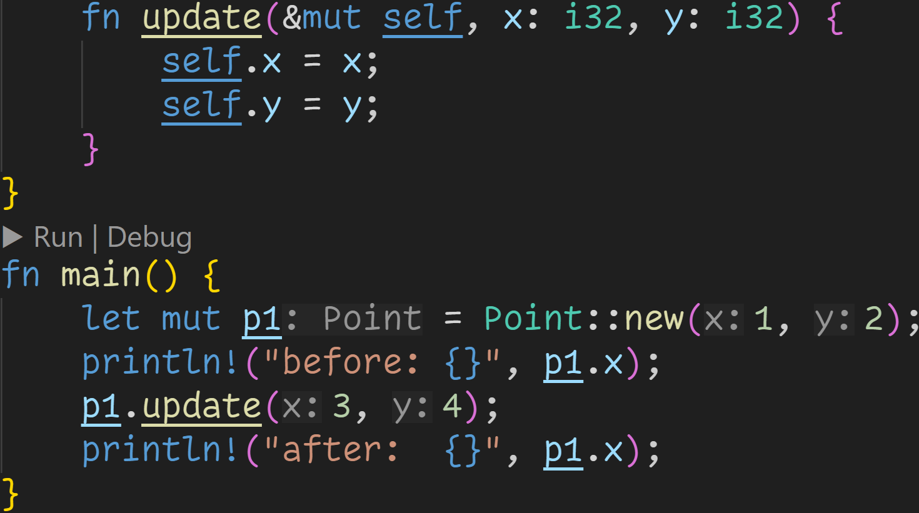

Slide 88
Methods can also take mutable references to the instance

Slide 89
To call a mutable method, we need to have a mutable instance

Slide 90
Rust automatically borrows for us, we don‘t need to write (&mut p1).update(...)

Slide 91
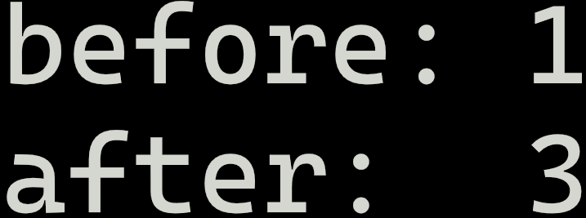

Slide 92
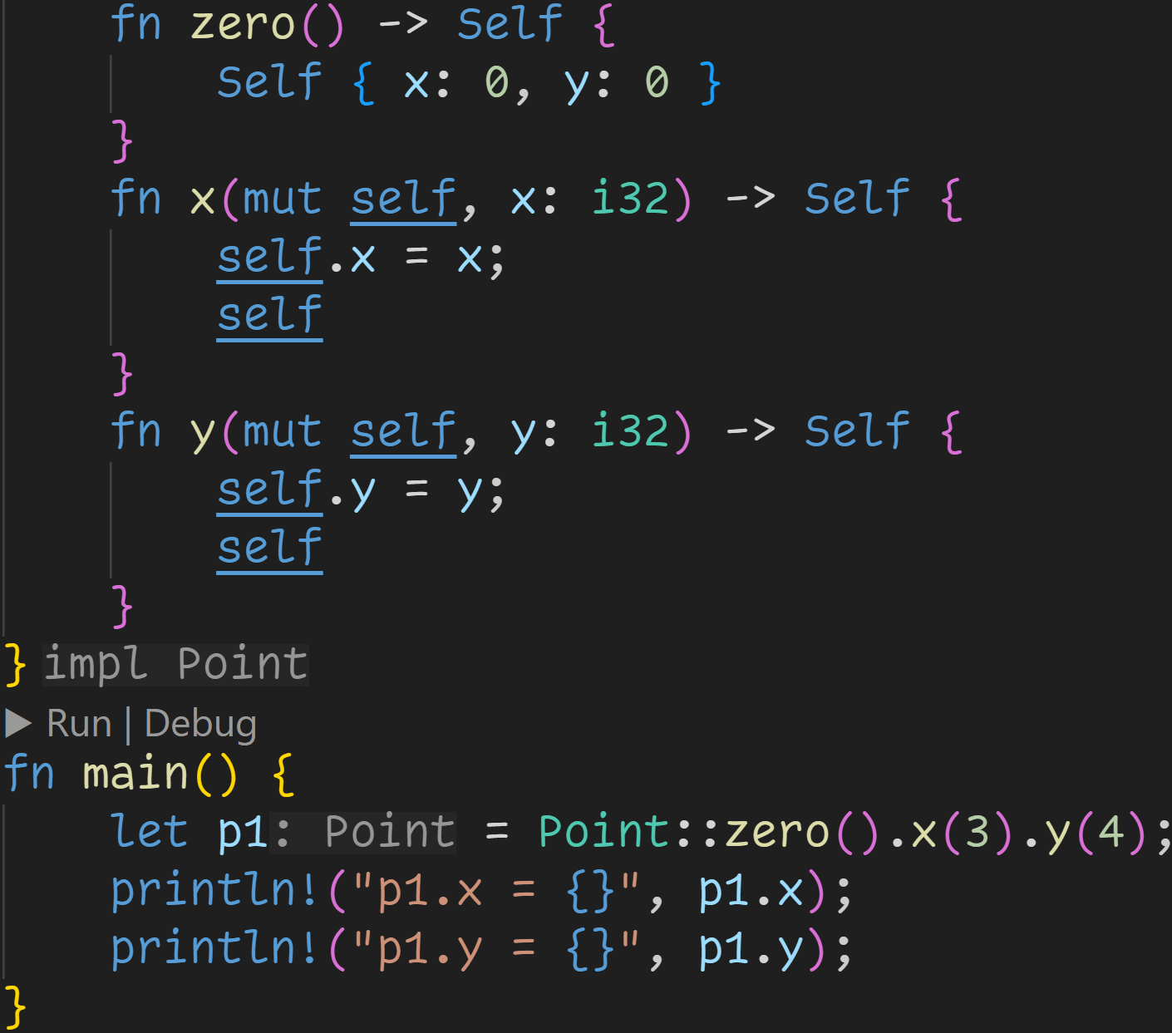

Slide 93
Final version of methods:
→ Taking ownership of the instance

Slide 94
Commonly seen with the builder pattern
→ Allows us to define a default instance, and set specific fields

Slide 95
Methods
Using our newfound knowledge, we can now use structs and methods for our ball application

Slide 96
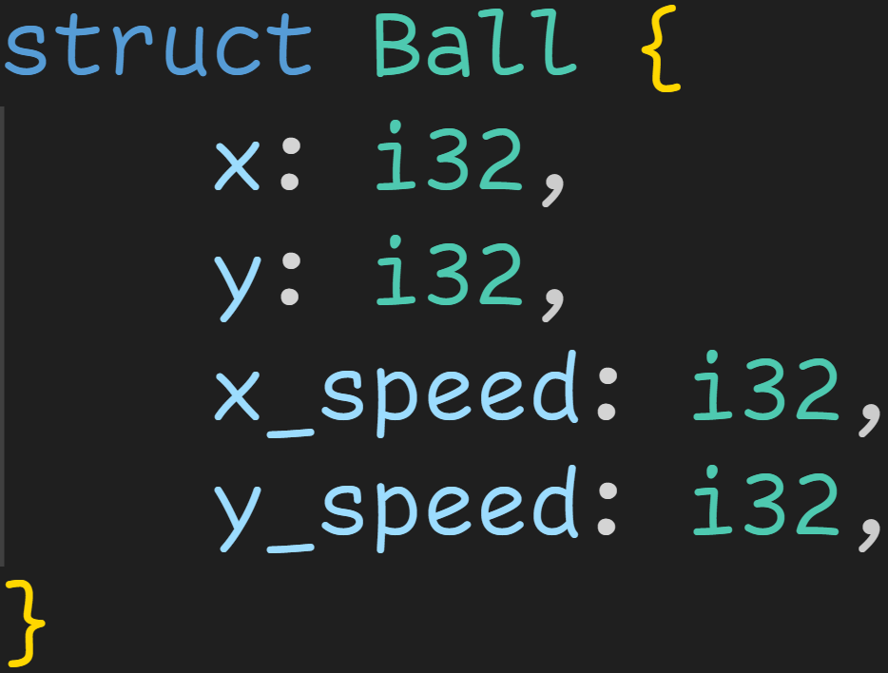
Methods

Slide 97
Methods
ball position in the world

Slide 98
Methods
velocity

Slide 99
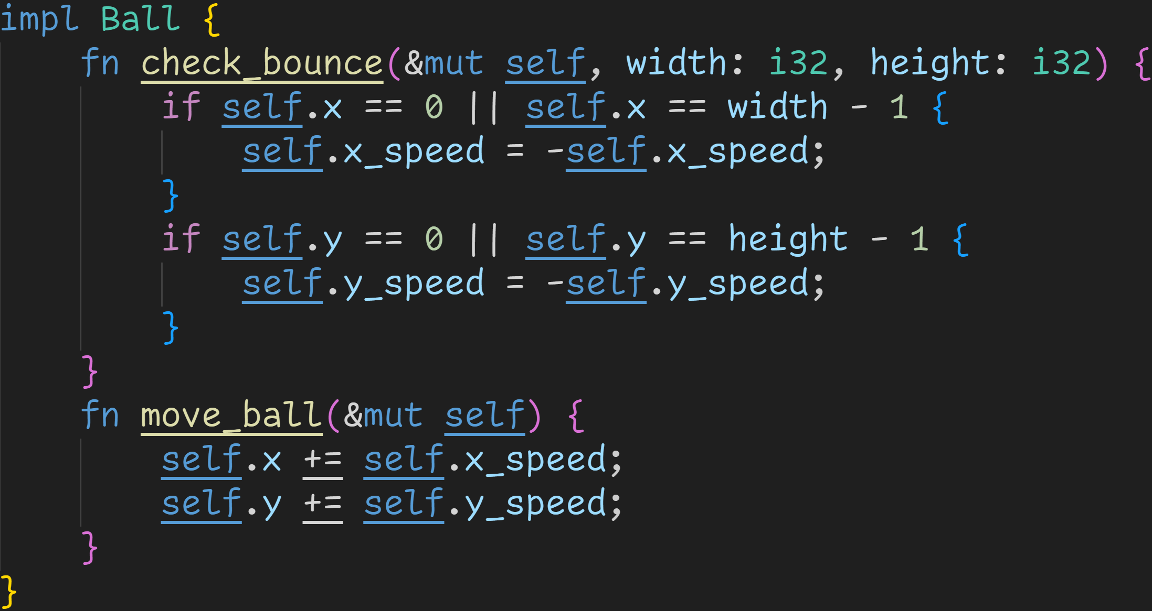
Methods

Slide 100
Methods
Usually you would not use a redundant name, but move is a keyword and can‘t be a function name :^) → Redundant because we‘re implementing the struct Ball

Slide 101
Methods
Check if our ball instance hit the wall of the given world

Slide 102
Methods
Move the ball in our world

Slide 103
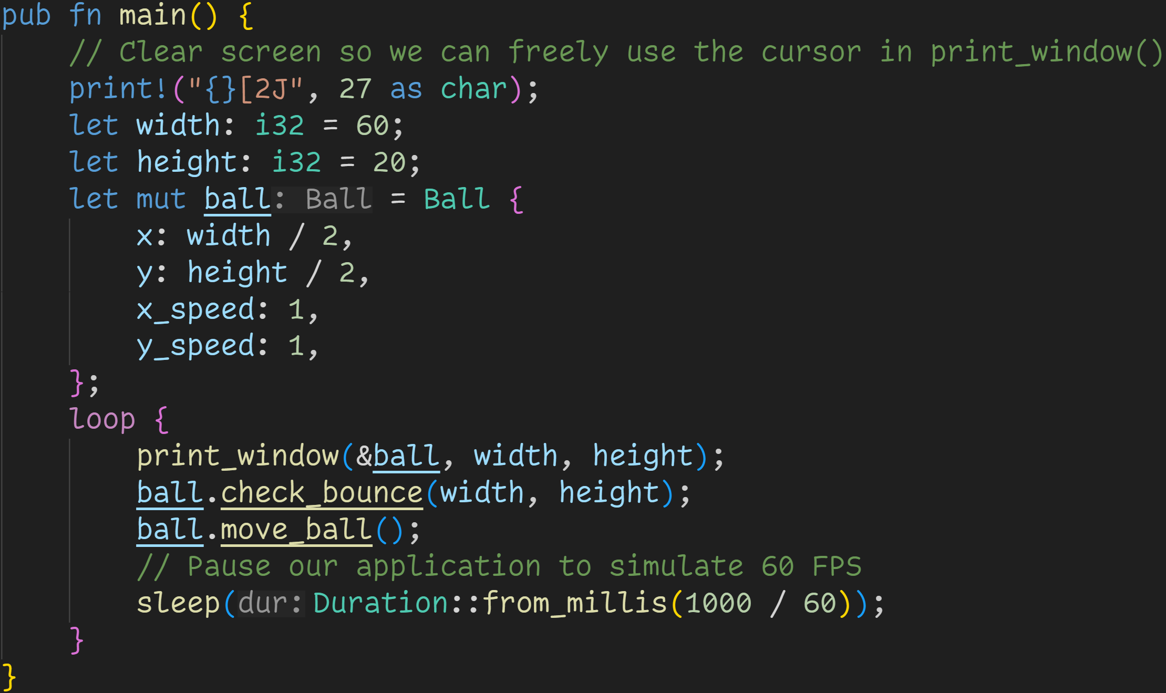
Methods

Slide 104
Methods
We now collected every relevant value for the ball state into a single struct

Slide 105
Methods
print_window() in the background was also updated to take an instance of type Ball

Slide 106
Methods
Our main loop is now more concise and readable, we can easily see what is going on

Slide 107
Methods
Additionally, because we isolated the ball logic, we can now easily create a whole list of balls :^)

Slide 108
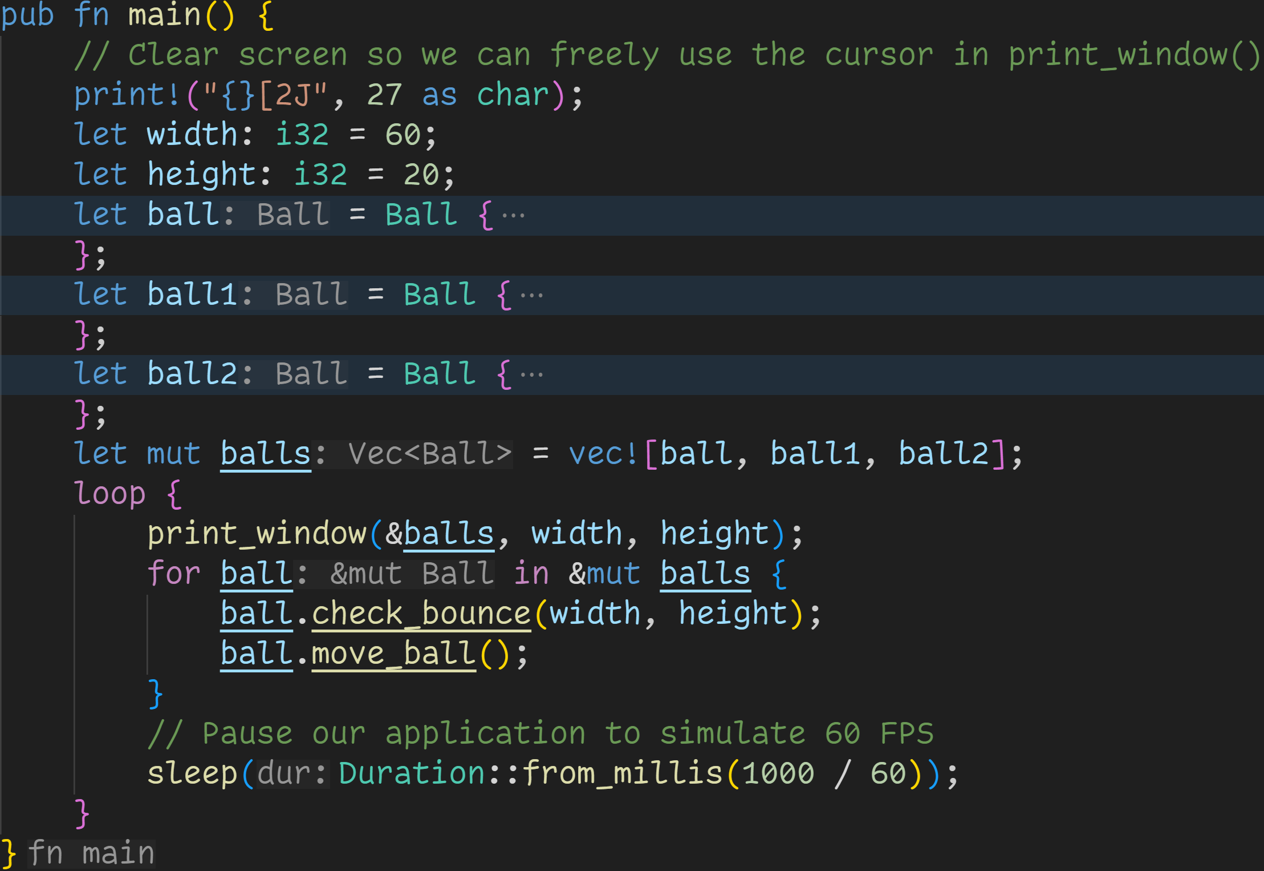

Slide 109
→ We simply create more instances

Slide 110
→ We simply create more instances
→ Add them to a list

Slide 111
→ We simply create more instances
→ Add them to a list → And apply our logic to all of them!

Slide 112
→ We simply create more instances
→ Add them to a list → And apply our logic to all of them! → And don‘t forget to draw all :^)

Slide 113
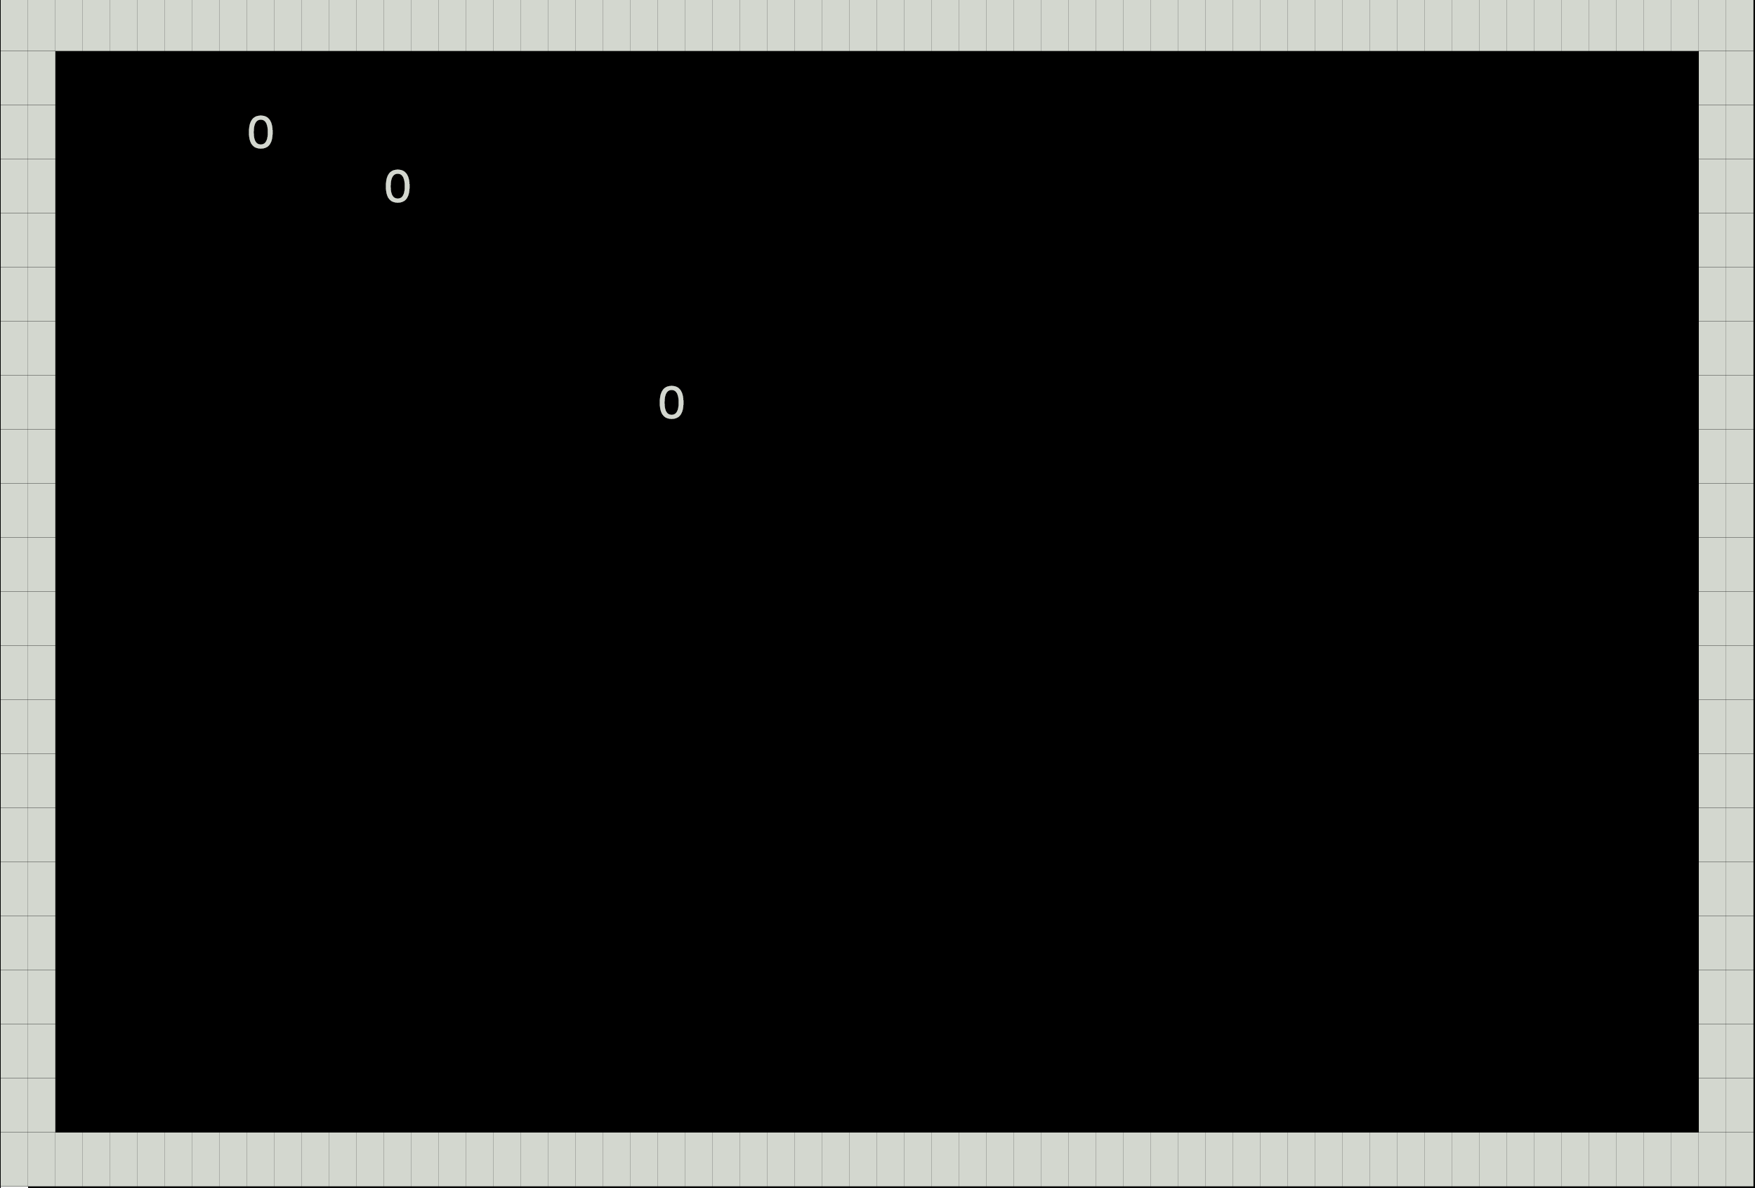
And just like that, we have three balls :^)

Slide 114
Intermission - Exercises
Time for exercises!

Slide 115
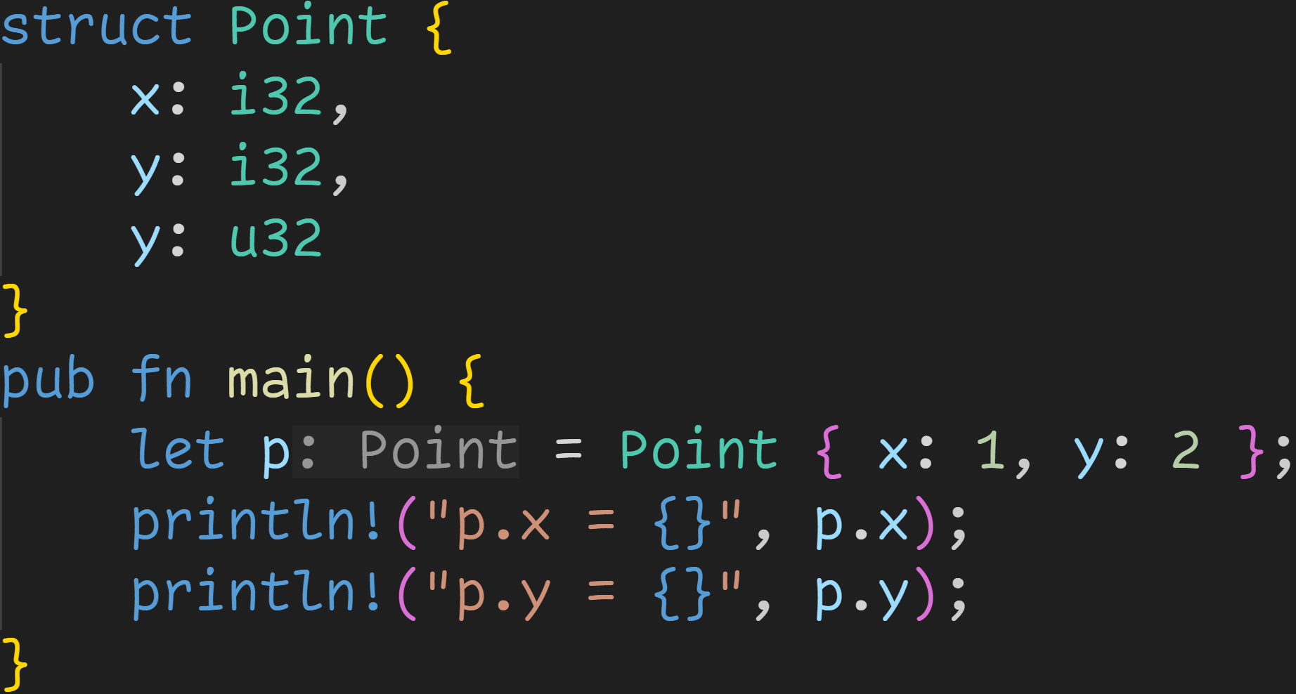
Intermission - Exercises
1/3

Slide 116
Intermission - Exercises
1/3
Does the code compile?
If yes, what does it print?

Slide 117
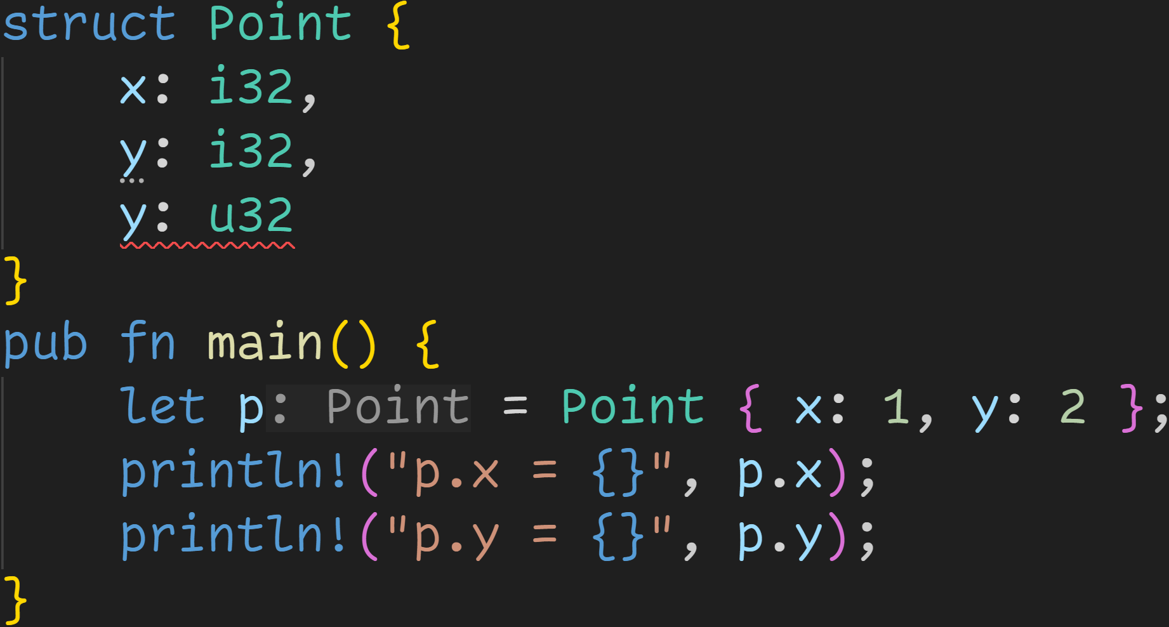
Intermission - Exercises
1/3
Does the code compile?
If yes, what does it print?
Nope, field names must be unique :)

Slide 118
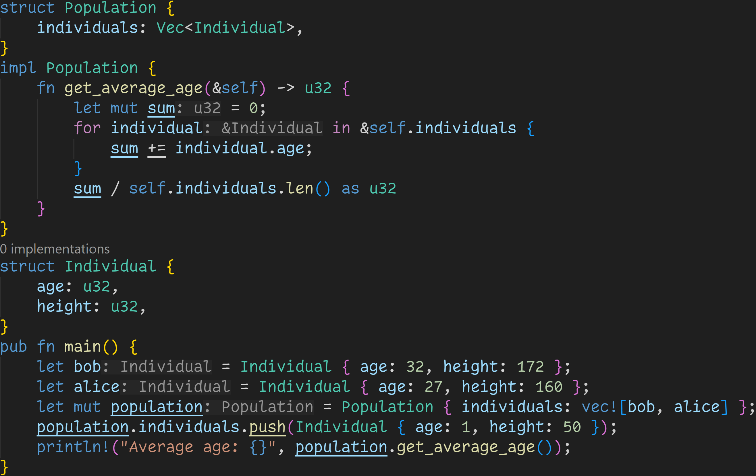
2/3

Slide 119
2/3
Does the code compile?
If yes, what does it print?

Slide 120
2/3
Does the code compile?
If yes, what does it print?
The code does compile! This code is valid!

Slide 121
2/3
Does the code compile?
If yes, what does it print?
The code does compile! This code is valid!
Again, we can omit the return if the return value is the last expression in a function
→ Don‘t forget to also omit the semicolon!

Slide 122
2/3
Does the code compile?
If yes, what does it print?
The code does compile! This code is valid!
After this line, there are three individuals in the population
→ Bob, aged 32
→ Alice, aged 27 → Baby, aged 1

Slide 123

2/3
Does the code compile?
If yes, what does it print?
The code does compile! This code is valid!
After this line, there are three individuals in the population
→ Bob, aged 32
→ Alice, aged 27 → Baby, aged 1 The average age is 32+27+1=60/3=20 :)

Slide 124
3/3
Do you see any potential problems with this code snippet?

Slide 125
3/3
Do you see any potential problems with this code snippet?
If the population is empty, we divide by 0

Slide 126
3/3
Do you see any potential problems with this code snippet?
Not using an associated function means we could set inhuman ages and heights

Slide 127
3/3
Do you see any potential problems with this code snippet?
We could add the same individual multiple times

Slide 128
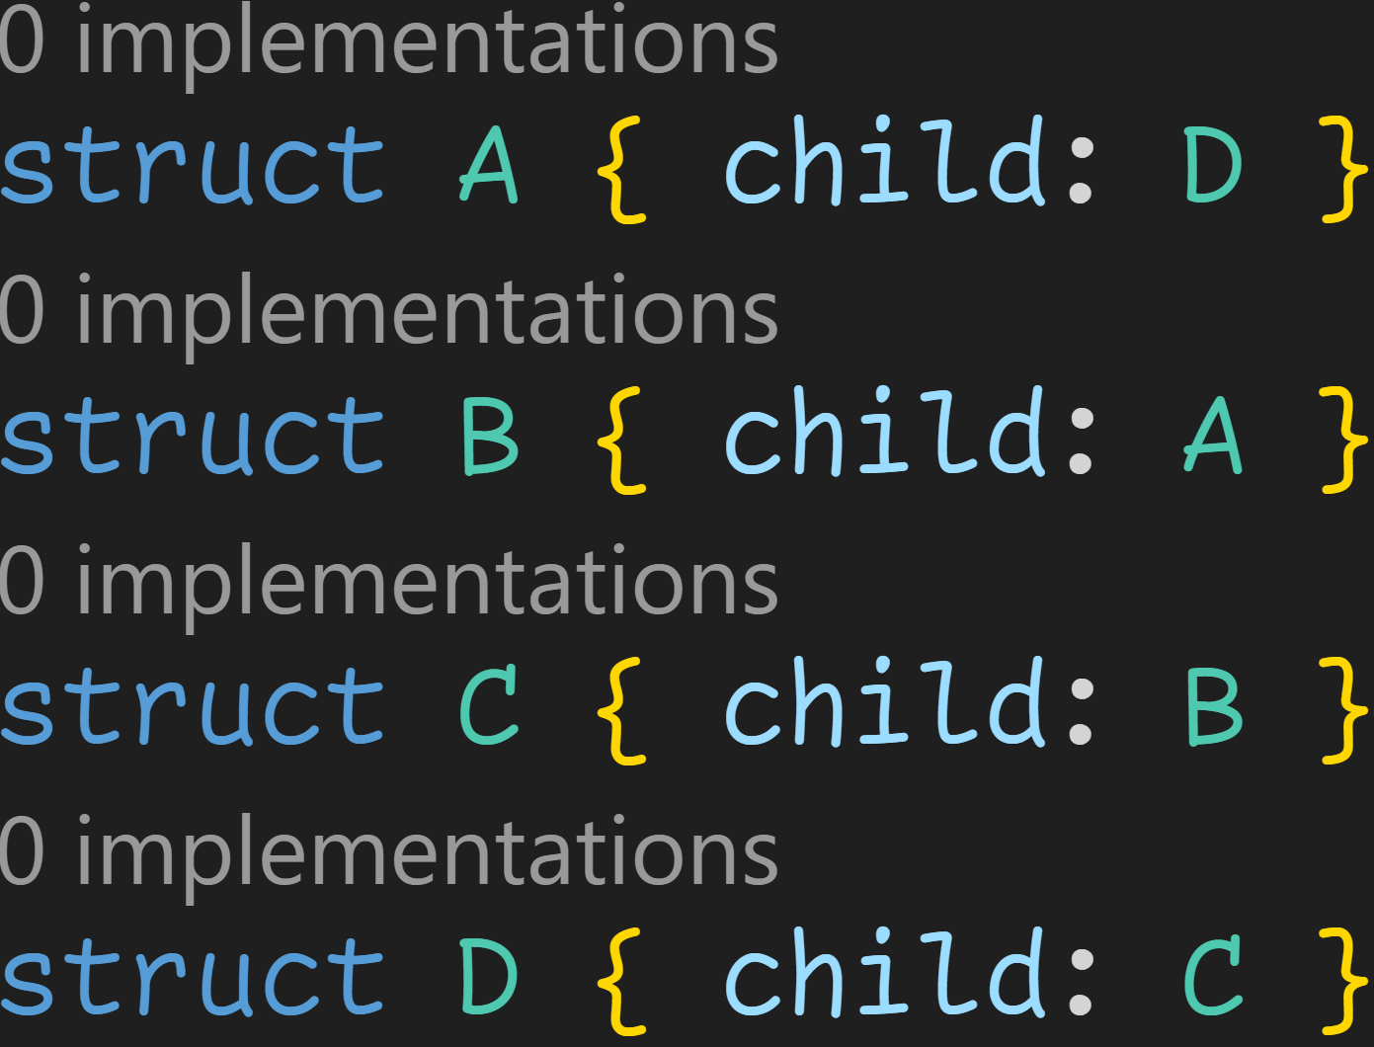
Intermission - Exercises
1/3

Slide 129
Intermission - Exercises
1/3
Does this work?

Slide 130
Intermission - Exercises
1/3
Does this work?
→ sizeof<A> = sizeof<D>

Slide 131
Intermission - Exercises
1/3
Does this work?
→ sizeof<A> = sizeof<D>
→ sizeof<B> = sizeof<A> = sizeof<D>

Slide 132
Intermission - Exercises
1/3
Does this work?
→ sizeof<A> = sizeof<D>
→ sizeof<B> = sizeof<A> = sizeof<D> → sizeof<C> = sizeof<B> = sizeof<A> = sizeof<D>

Slide 133
Intermission - Exercises
1/3
Does this work?
→ sizeof<A> = sizeof<D>
→ sizeof<B> = sizeof<A> = sizeof<D> → sizeof<C> = sizeof<B> = sizeof<A> = sizeof<D> → sizeof<D> = sizeof<C> = sizeof<B> = sizeof<A> = sizeof<D>

Slide 134
Intermission - Exercises
1/3
Does this work?
→ sizeof<A> = sizeof<D>
→ sizeof<B> = sizeof<A> = sizeof<D> → sizeof<C> = sizeof<B> = sizeof<A> = sizeof<D> → sizeof<D> = sizeof<C> = sizeof<B> = sizeof<A> = sizeof<D> → To calculate the size of D, we need the size of D → Recursive → Does not work

Slide 135
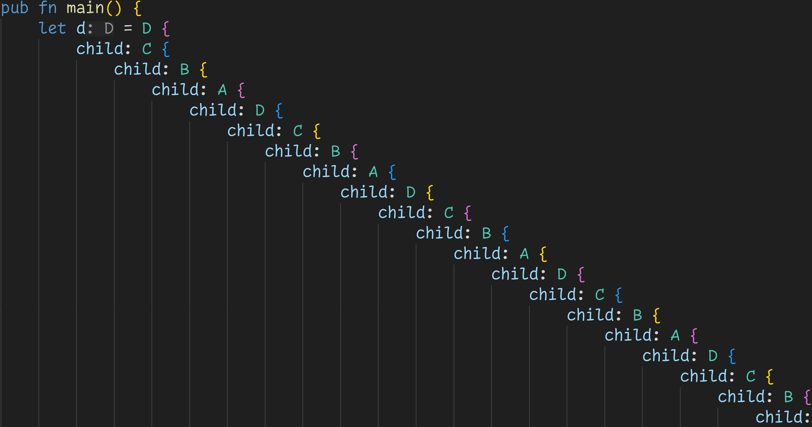
Intermission - Exercises
Every field must have a value
→ We could never instantiate this struct anyway :(

Slide 136
Next time
Traits

